Slide 1


Climate Change Adaptation Research
Project updates 2020
Sx genecology/CC field trial
Assisted Migration Adaptation Trial (AMAT)
Climate Based Seed Transfer (CBST)
Multiple seedlot study
Extreme event frequency study
Drought study (new!)
Future plantation orphans (new!)
Species transferability (new!)
Remote sensing in genetics field trials (new!)

Slide 2
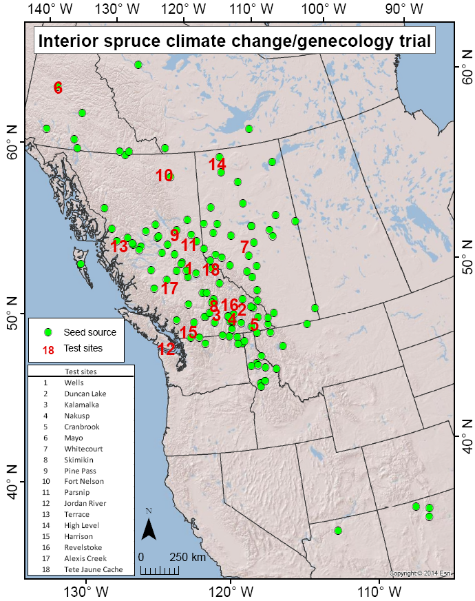
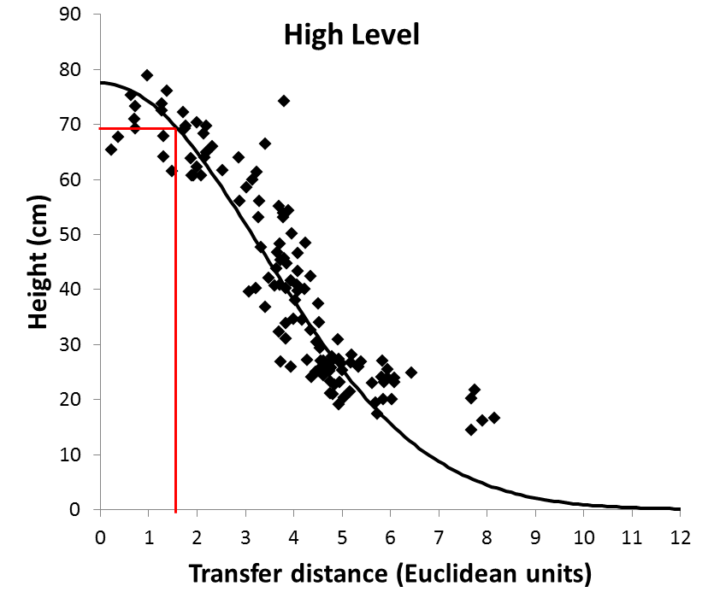
Climate Change Adaptation Research
Project updates 2020
Sx genecology/CC field trial
Seedlot transferability → CBST
Established 2005
128 pops at 17 test sites
Notes:
No exaggeration – one of best prov tests in world
Widest population and test site climate range
Well designed
Well maintained
age 14

Slide 3
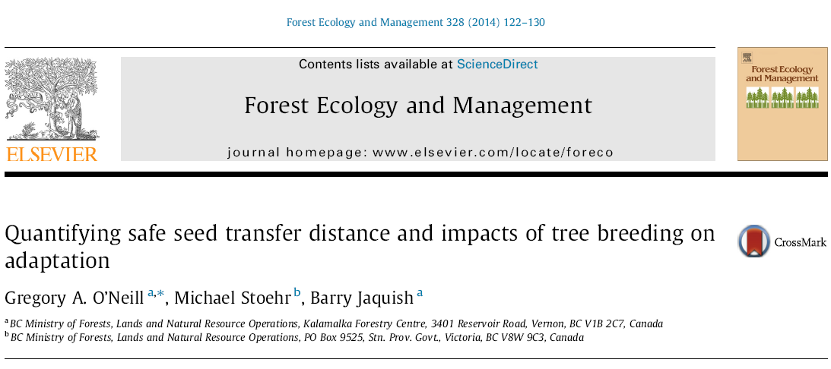
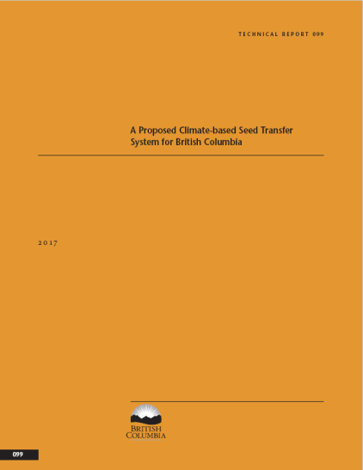
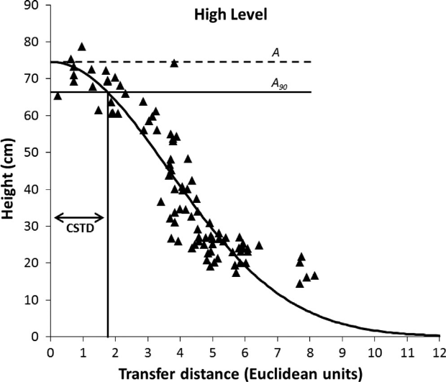
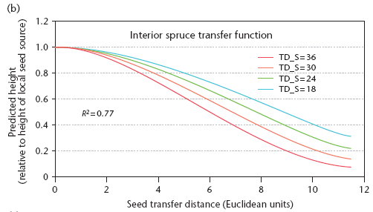
Climate Change Adaptation Research
Project updates 2020
Sx genecology/CC field trial
Notes:
Widest range of pops and test sites in world
Not just collecting dust

Slide 4
Climate Change Adaptation Research
Project updates 2020
Sx genecology/CC field trial
Wx
Wx
Wx
Wx
Wx
Wx
Wx
Wx
Wx
2004
2005
2006
2007
2008
2009
2010
2011
2012
2013
2014
2015
2016
2017
2018
2019
2020
2021
2022
Sow
Thin
Thin
Thin
Thin
Thin
Thin
Thin
Plant
Measure, brush age-3
Measure, brush age-6
Measure, brush age-10
Measure, brush age-16
Notes:
Minor tweeks based on new analysis

Slide 6
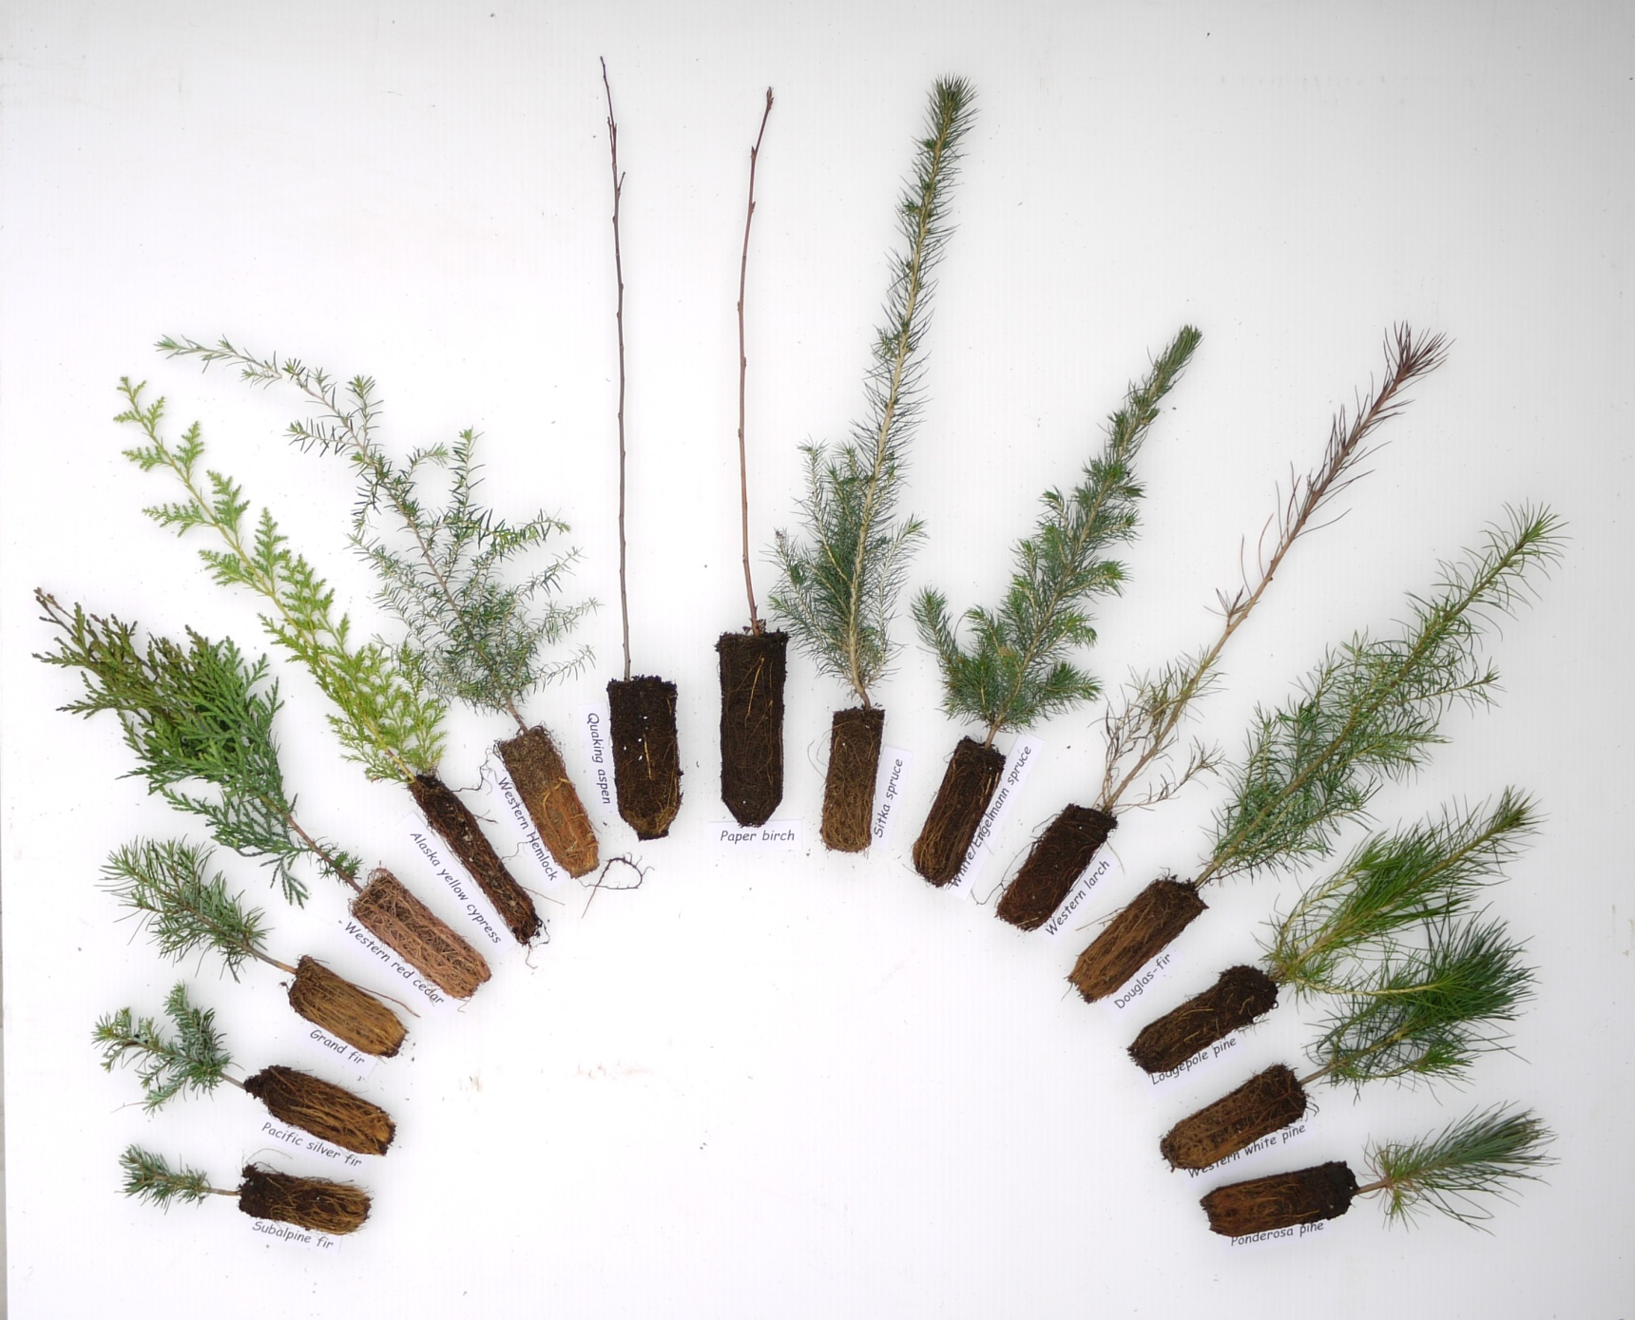
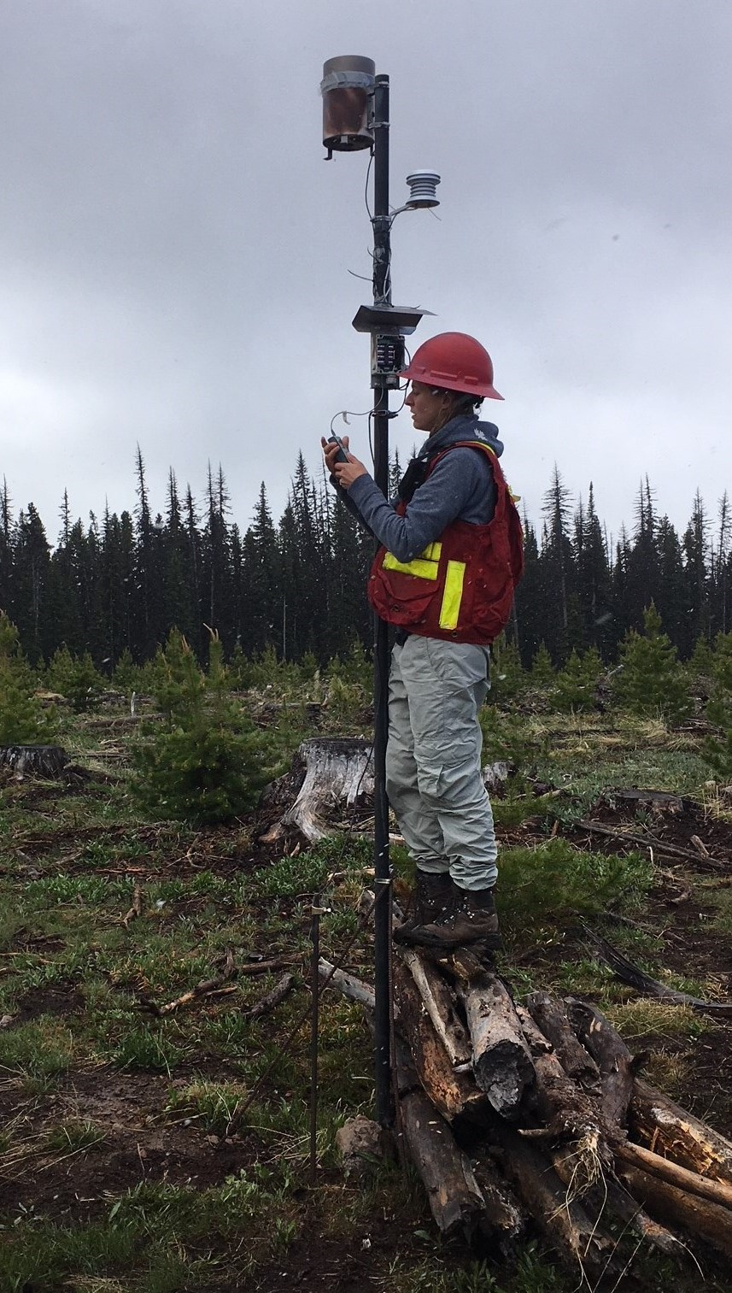
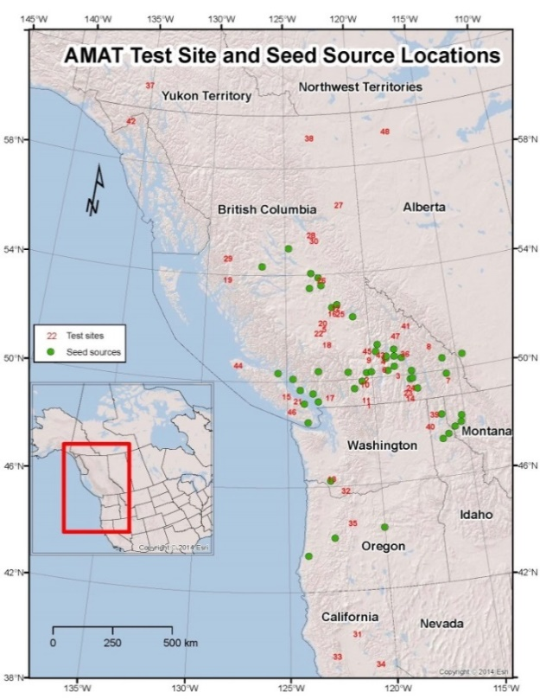
Climate Change Adaptation Research
Project updates 2020
Assisted Migration Adaptation Trial (AMAT)
Established 2009-12
48 test sites
15 species, 48 seedlots (mostly Class A)
Photo: Ward Strong
Map: Amy Vallarino
Seedlot transferability → CBST
Notes:
Unique:
SO focus
multi-species
outside sp range
Long dist tx > ++ maladaptation > ++ brushing

Slide 7
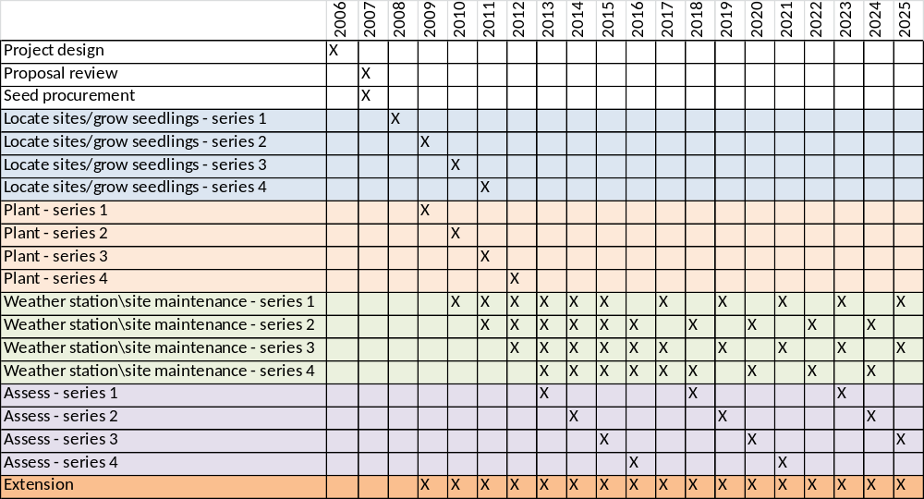
Climate Change Adaptation Research
Project updates 2020
AMAT

Slide 9
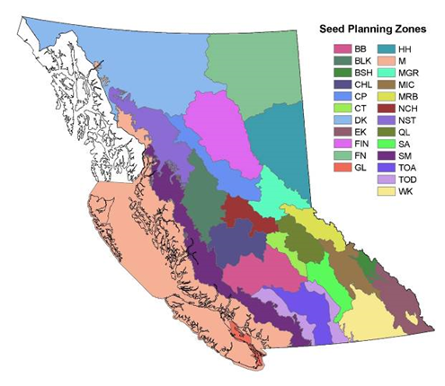
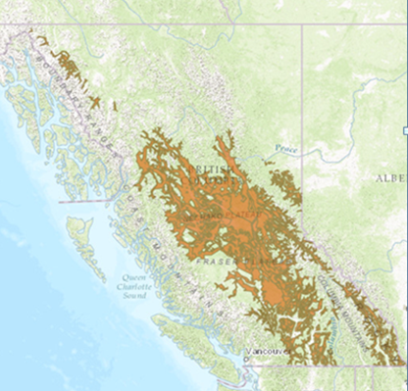
Climate Change Adaptation Research
Project updates 2020
Climate Based Seed Transfer (CBST)
Current seed transfer zones
(geography)
CBST
(climate)
Better matching of seedlots with plantations
Facilitates accurate assisted migration
Maximizes deployment area

Slide 10
Climate Change Adaptation Research
Project updates 2020
Climate Based Seed Transfer (CBST)
2011
2012
2013
2014
2015
2016
2017
2018
2019
2020
2021
Sci WG forms
FGS discussion
Tool v1 released
FGS reviews Tech Report
FGS discussion
External reviews of Tech Report
Policy and Stakeholder WGs form
Tech Report published
AdapTree final report
FGS reviews tool
CF approves expedited Alternative process
SPAR revised to include CBST
CFS amended
Minor revisions
Minor revisions
BEC11
ClimateBC 6.21
Variable weighing
2 additional y of AM
Eliminate GBST
Notes:
Minor tweeks based on new analysis

Slide 12
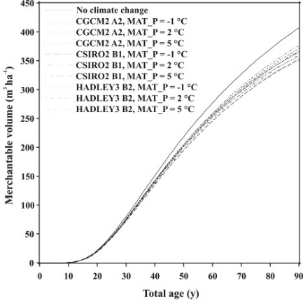
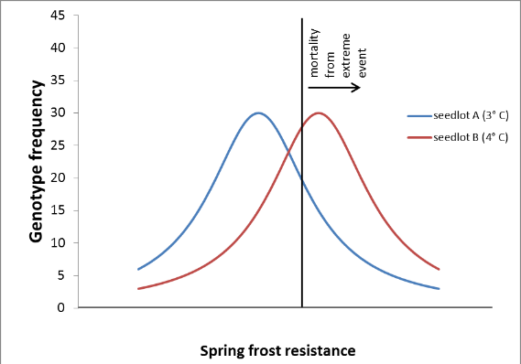
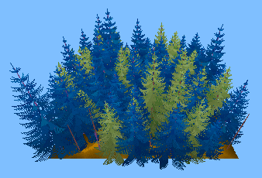
Climate Change Adaptation Research
Project updates 2020
Multiple Seedlot – Genetic Diversification Study
+
+
= ?
Image: Dave Simpson
Objectives
Examine opportunities for using multiple, differently-adapted seedlots as a bet-hedging strategy to buffer extreme climate events
Develop a climate-sensitive TASS program
Funding 2018/19, 2019/20
Forest Enhancement Society ($76,000)
FAIB ($25,000)
Funding 2020/21, 2021/22, 2022/23
OCF Research Program (Timber Production) ($153,000)
Team
Tongli Wang, Derek Sattler, Kate Peterson, Greg O’Neill
Notes:
In case you were wondering – not just trees, people too are differently adapted

Slide 13
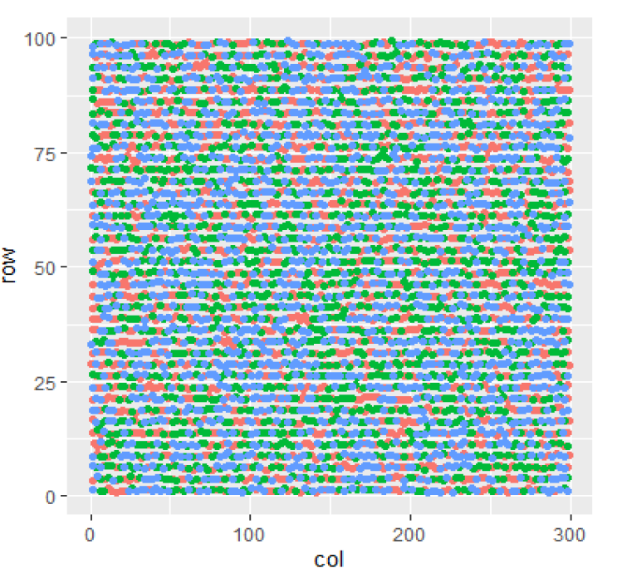
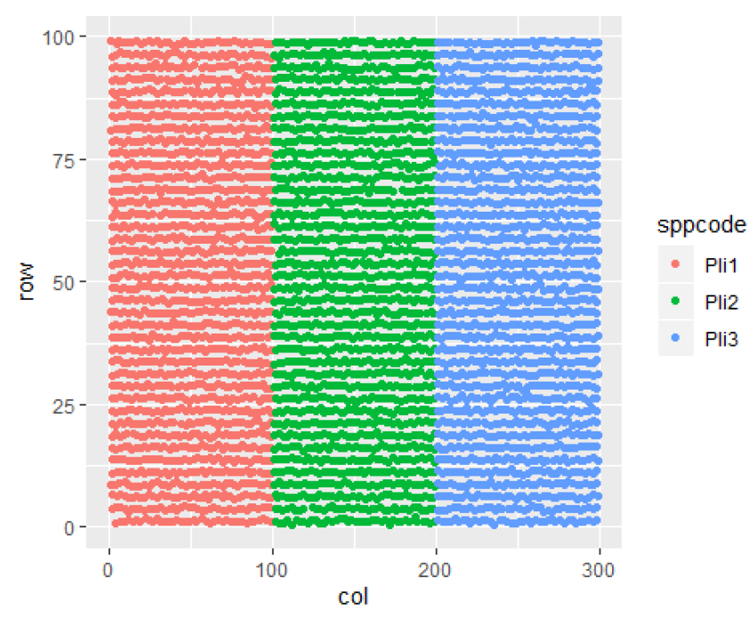
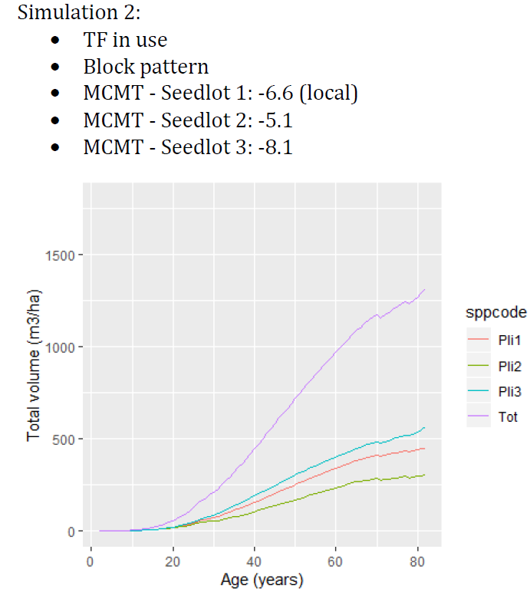
Climate Change Adaptation Research
Project updates 2020
Multiple Seedlot – Genetic Diversification Study

Slide 15
Climate Change Adaptation Research
Project updates 2020
Extreme event study
Notes:
Amy – annual weather (Env Can) 1895-present for 12 locations in BC

Slide 16
Climate Change Adaptation Research
Project updates 2020
Extreme event study

Slide 17
Climate Change Adaptation Research
Project updates 2020
Extreme event study

Slide 18
Climate Change Adaptation Research
Project updates 2020
Extreme event study

Slide 19
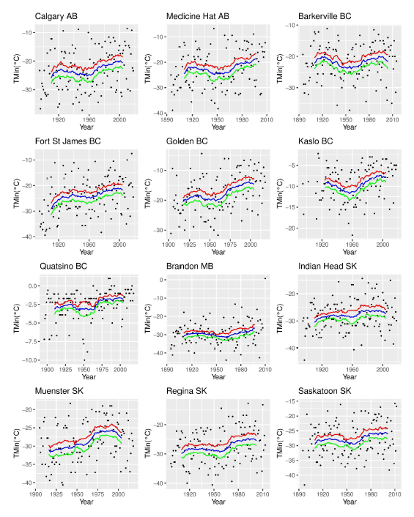
Climate Change Adaptation Research
Project updates 2020

Slide 20
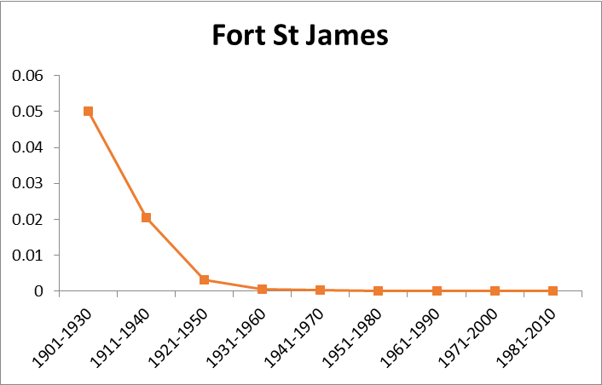
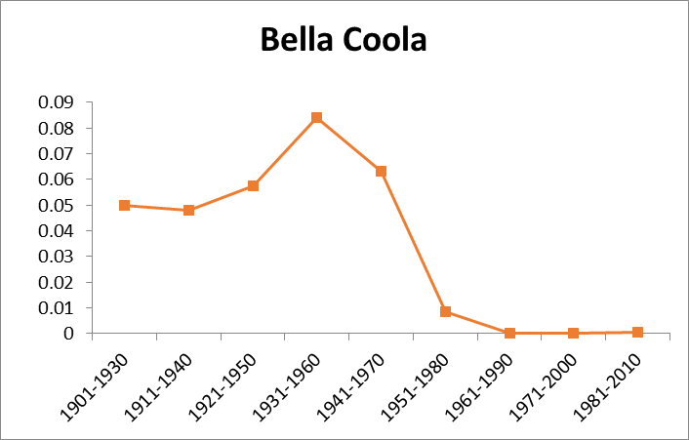
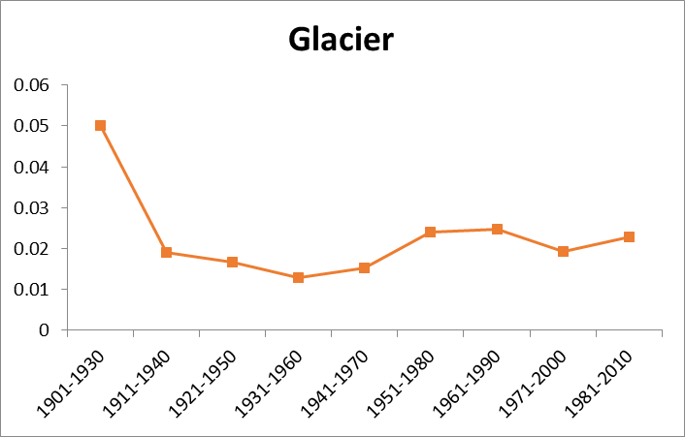
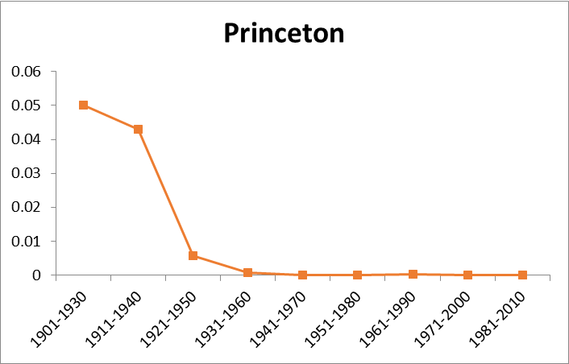
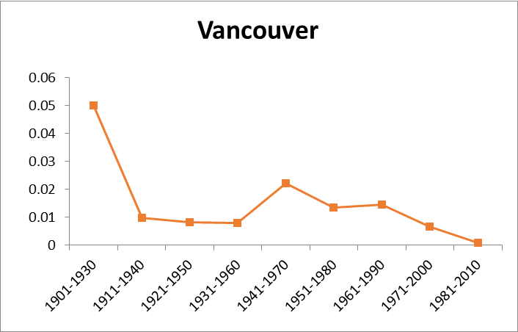
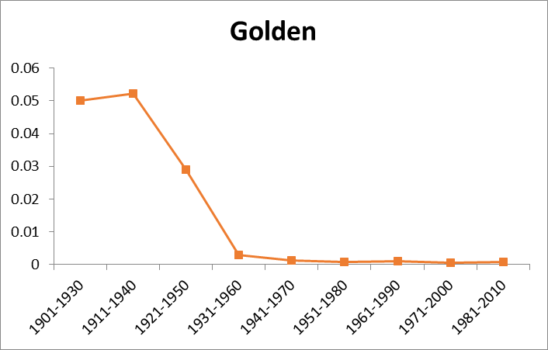
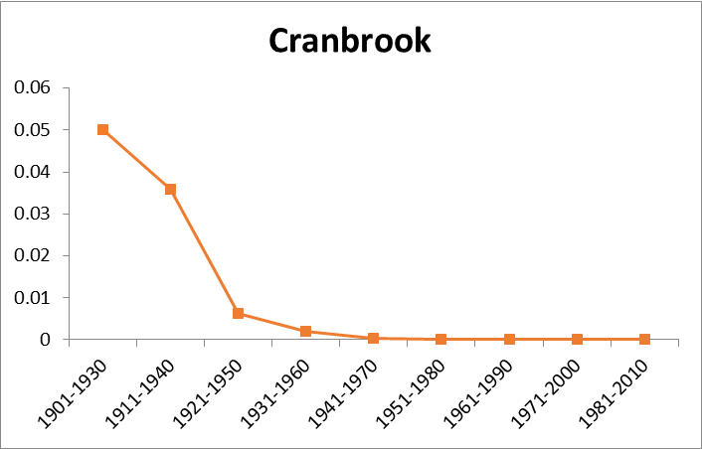
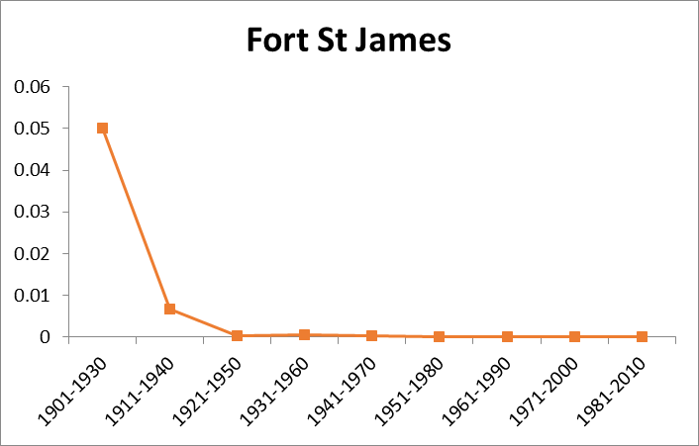
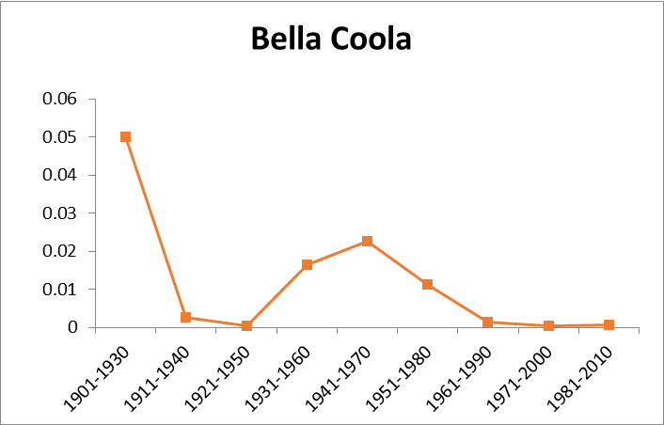
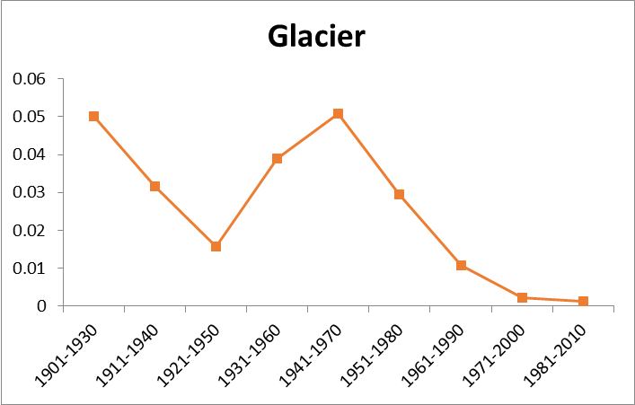
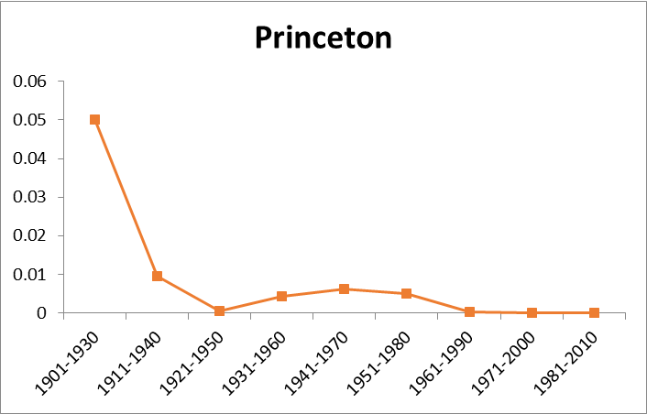
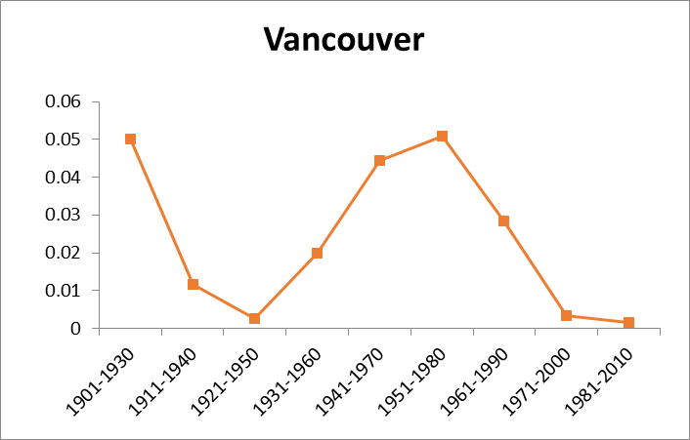
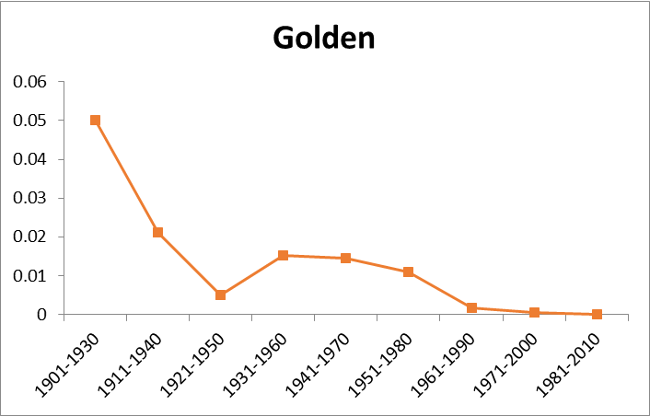
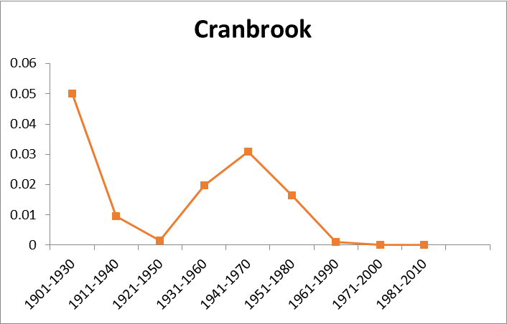
March min temp – probability of exceeding an extreme event temp
Oct min temp – probability of exceeding an extreme event temp
Notes:
Industrial pollution without controls
Volcanoes

Slide 22
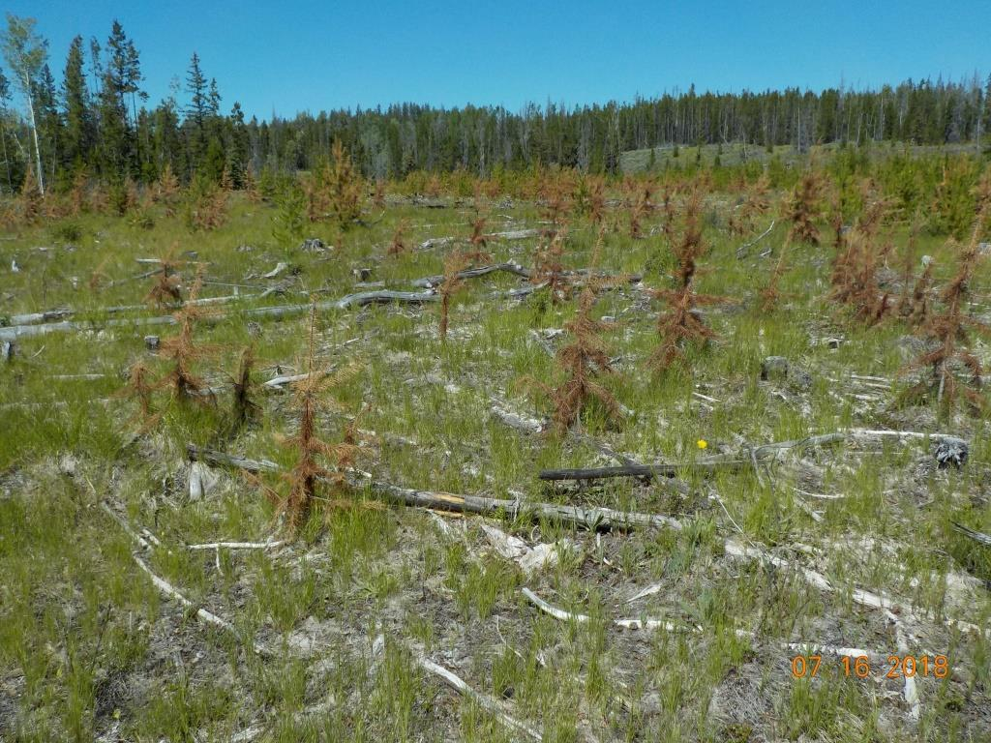
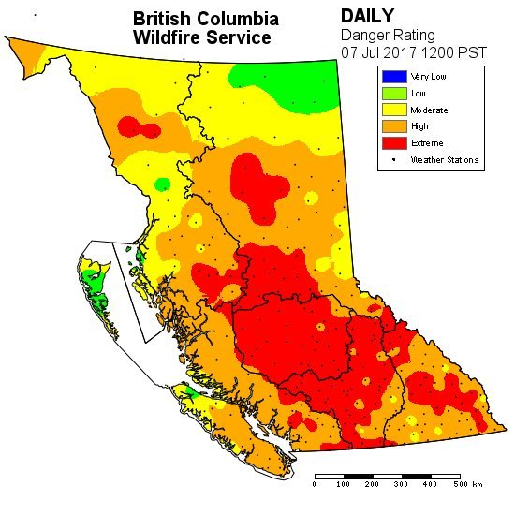
Climate Change Adaptation Research
Project updates 2020
Paired-tree drought study
Photo: Andy Slizak

Slide 23
Climate Change Adaptation Research
Project updates 2020
Paired-tree drought study
Objective
Identify ring, crown traits and tree size traits related to drought tolerance
Materials
46 pairs of Pl trees – one live, other recently drought-killed
4 natural stands > 30 y-old in Okanagan Valley
Methods
Calculate drought tolerance indices using ring widths pre- and post-2003 drought.
Do the indices from 2003 drought predict survival in 2017 and 2018 droughts?
Do crown or size traits differ between live and dead trees?
Funding
LBIS - $3400 (dendro analyses)
Team
Hardy Griesbauer, Rachel Reed, Greg O’Neill

Slide 24
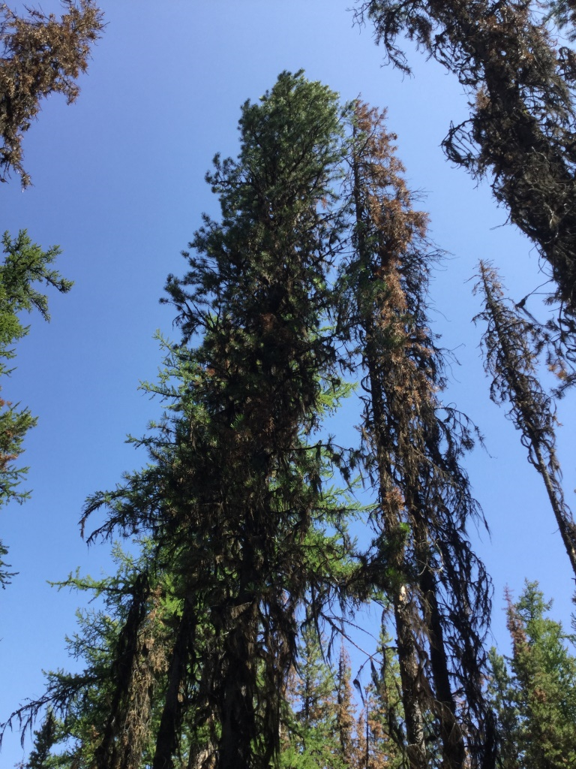
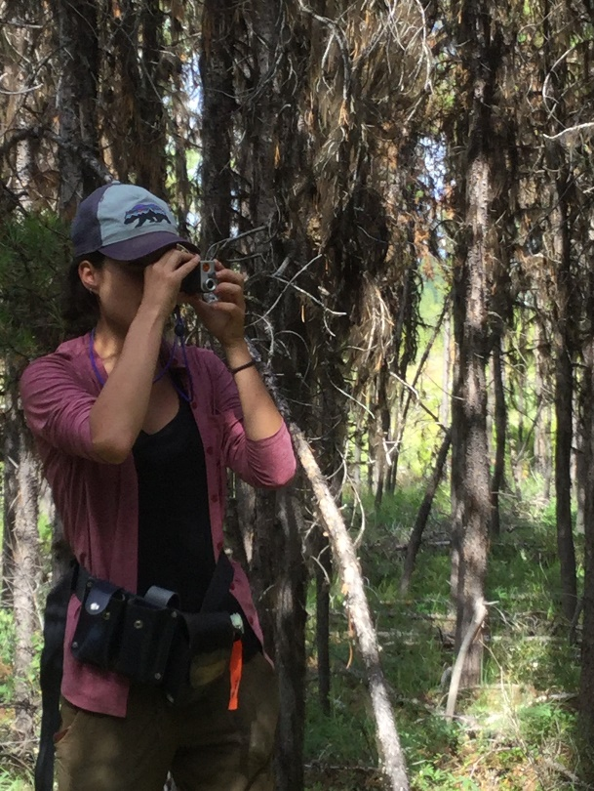
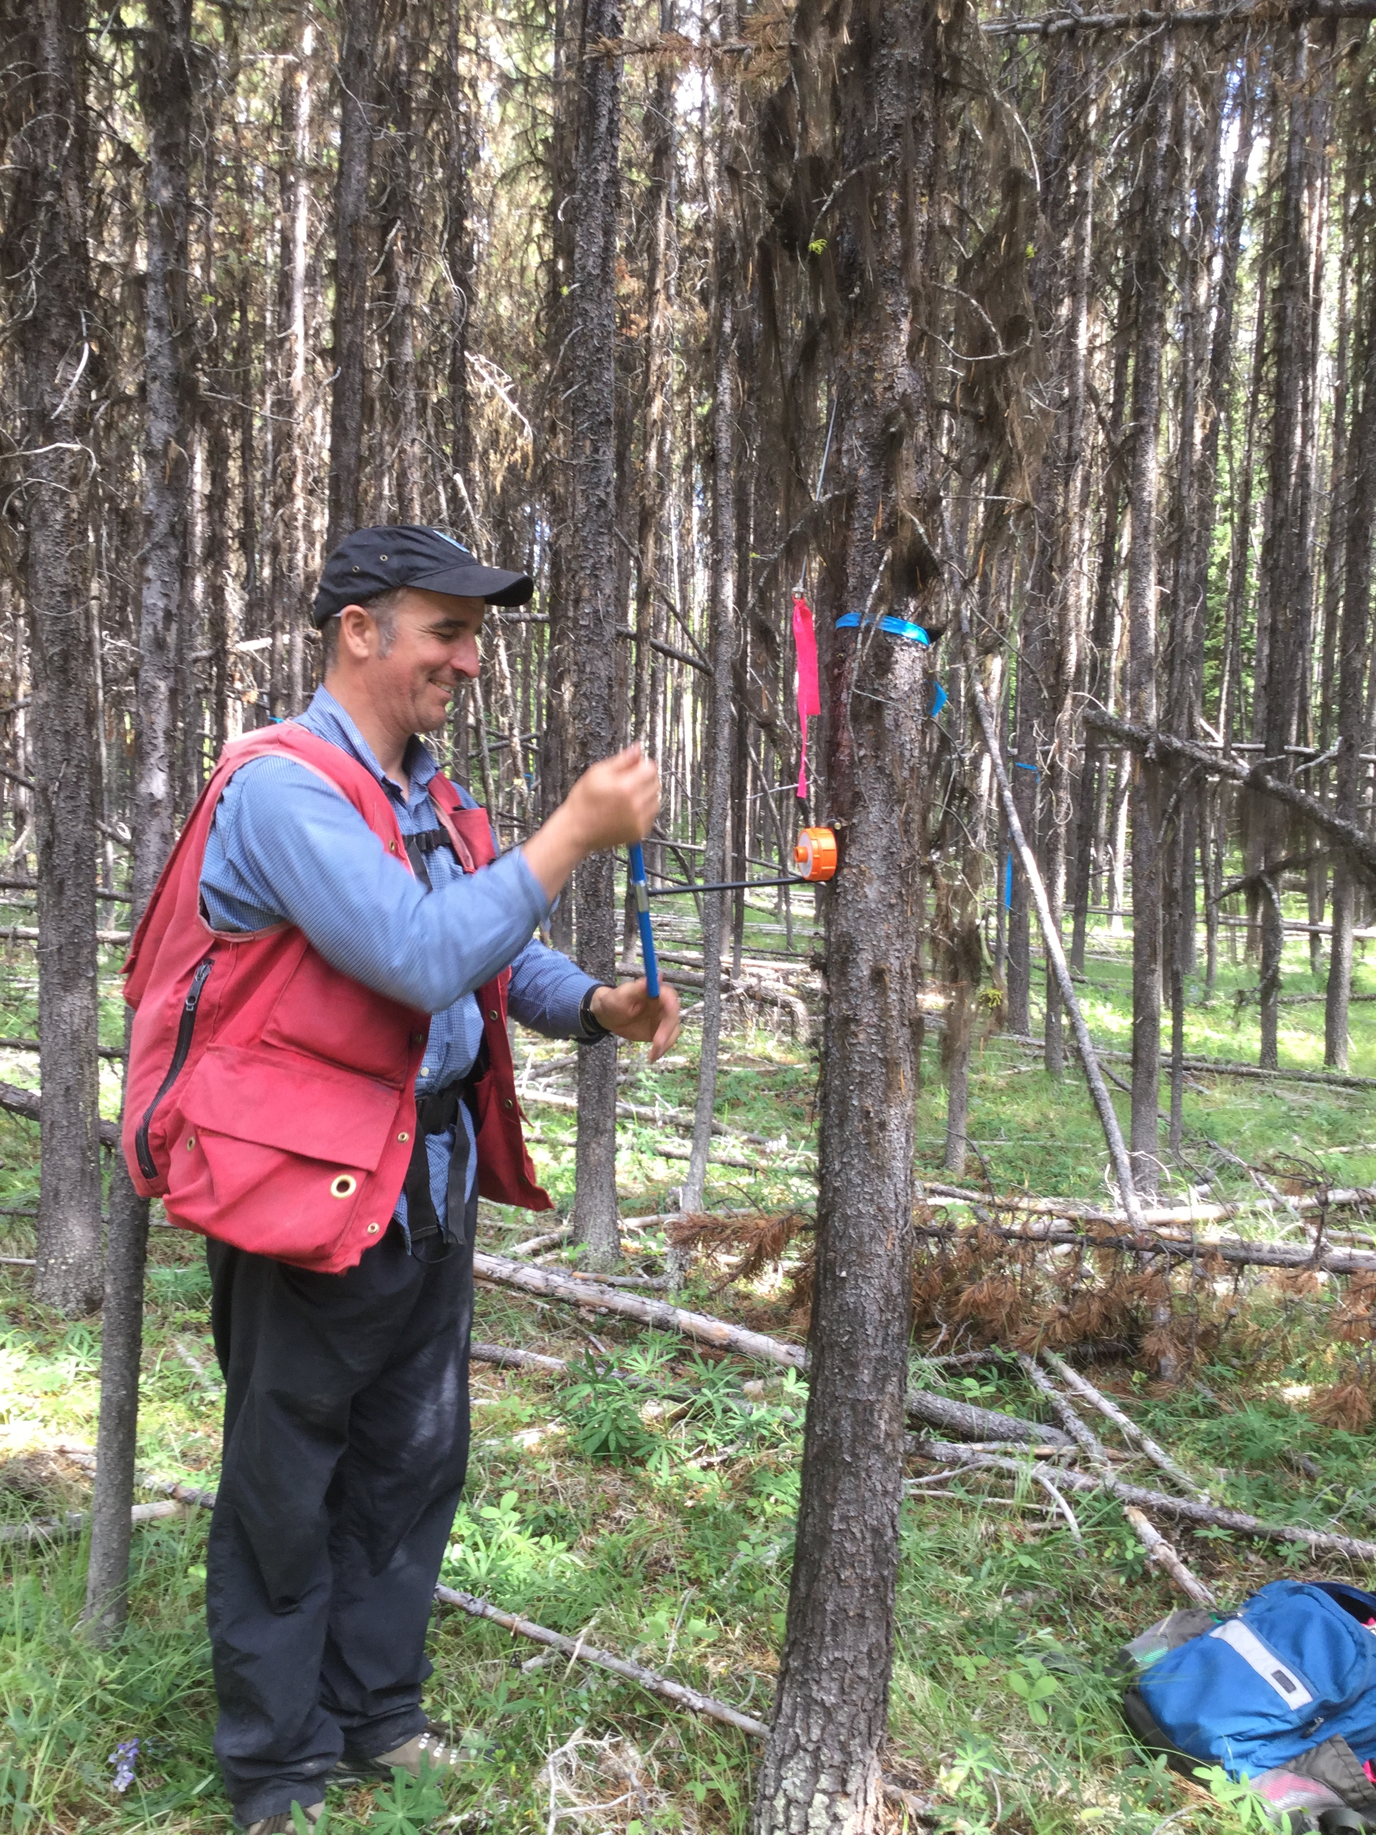
Climate Change Adaptation Research
Project updates 2020
Paired tree drought study

Slide 26
Climate Change Adaptation Research
Project updates 2020
Future plantation orphans
For which BECvars will we find no eligible BECvar seed sources in the future?
Where in the USA might we find seed sources or parent trees adapted to these orphaned plantation BECvars today?

Slide 27
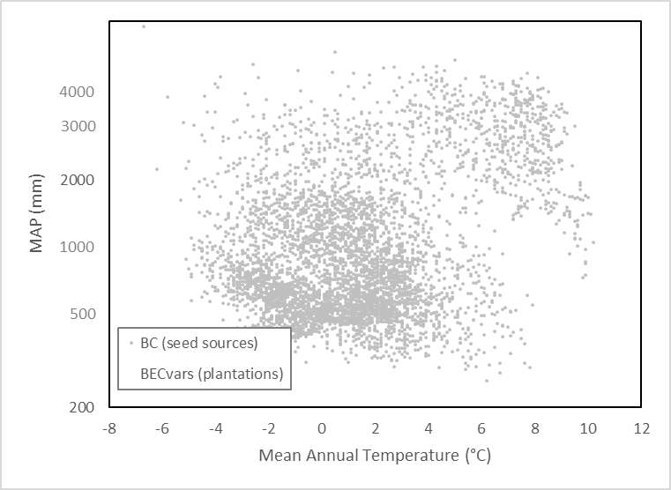
Climate Change Adaptation Research
Project updates 2020

Slide 28
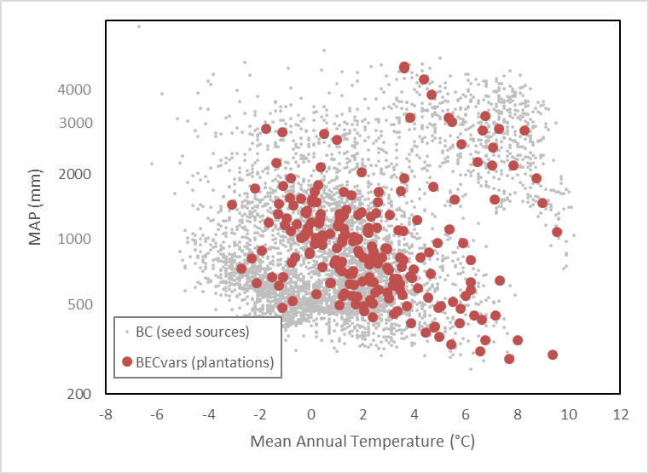
Climate Change Adaptation Research
Project updates 2020

Slide 29
Climate Change Adaptation Research
Project updates 2020

Slide 30
Climate Change Adaptation Research
Project updates 2020

Slide 31
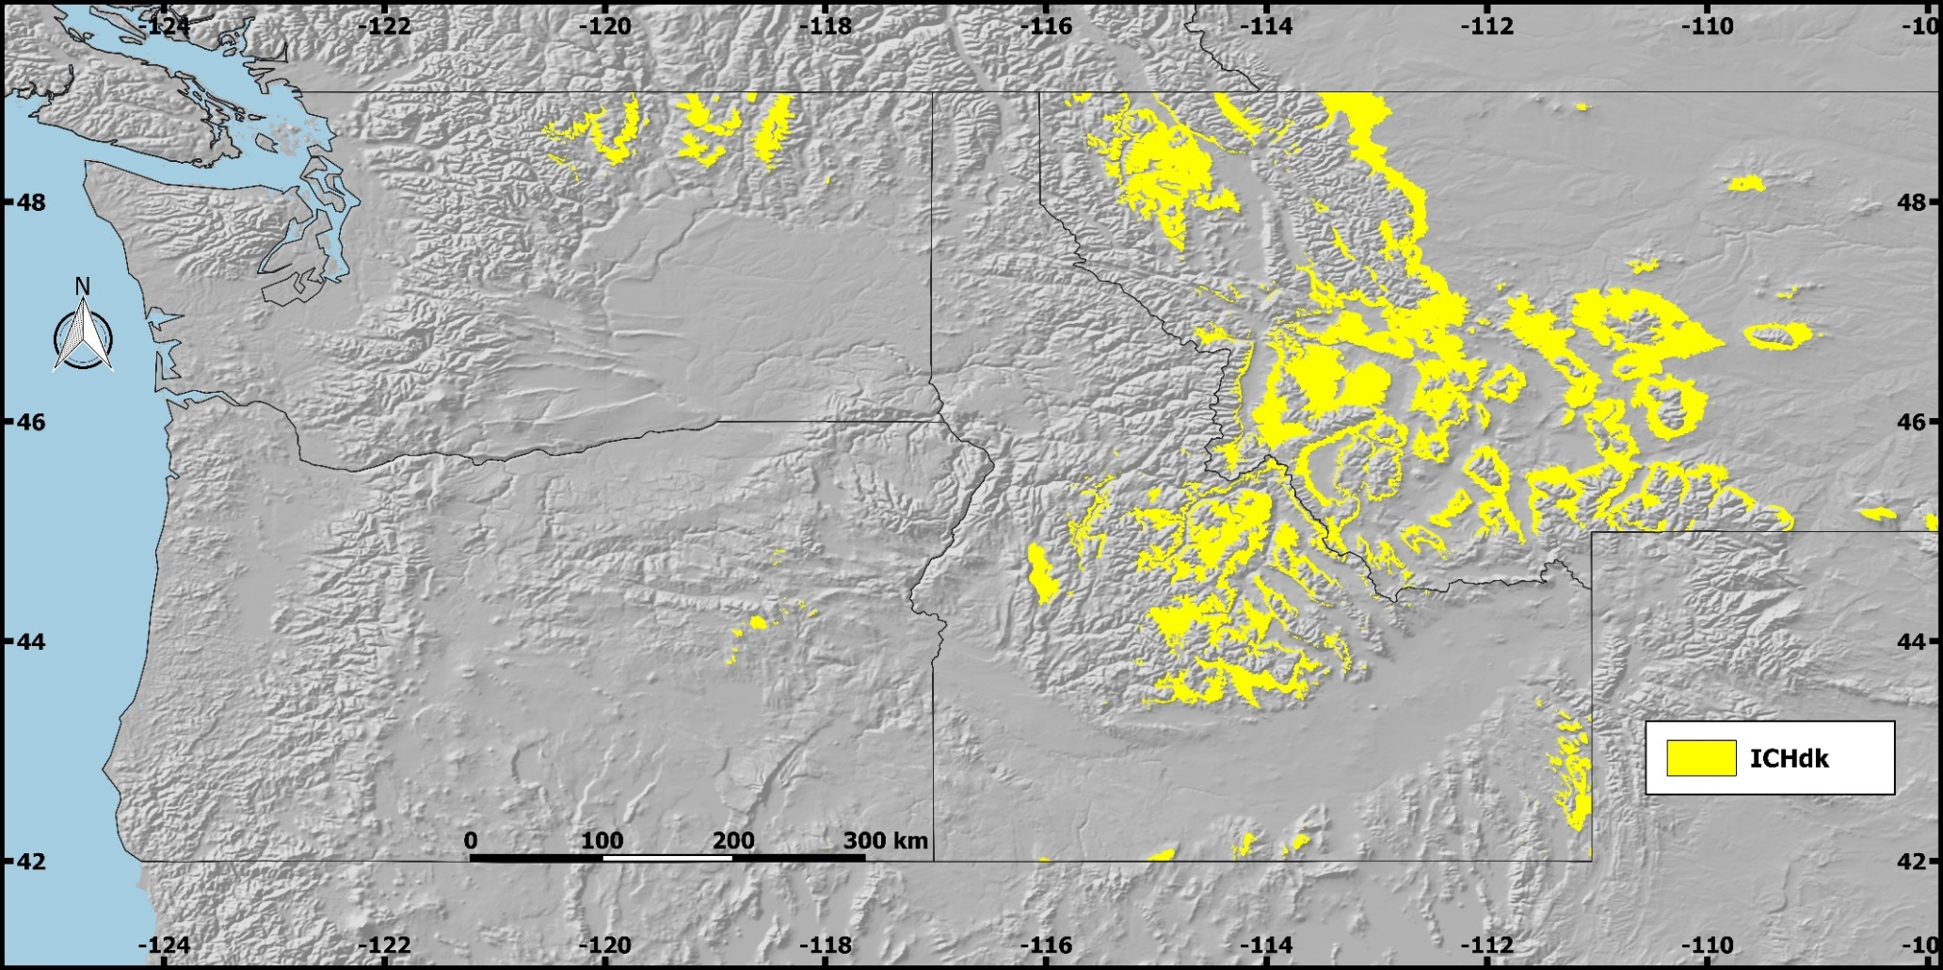
Climate Change Adaptation Research
Project updates 2020
Future plantation orphans

Slide 33
Climate Change Adaptation Research
Project updates 2020
Species transferability
Question
To what extent do species differ in their safe seed transfer distance?
Methods
Pl, Sx, Fdi, Bc, and Hw prov data
Build transfer function
Quantify safe seed transfer distance
Funding
UC Davis
Team
Joseph Stewart (UC Davis), Jessica Wright (USDA FS), Greg O’Neill

Slide 34
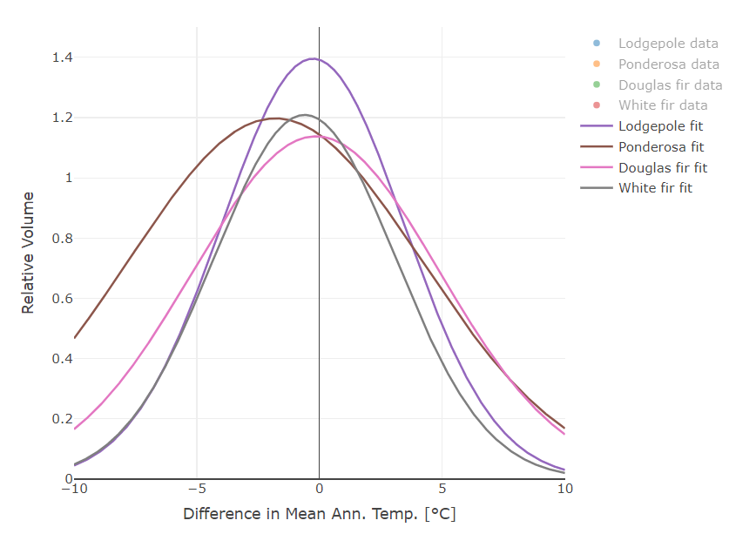
Climate Change Adaptation Research
Project updates 2020
Species transferability

Slide 36
Climate Change Adaptation Research
Project updates 2020
Remote sensing in genetic field trials
Question
Can remote sensing (multi-spectral imaging) be used to assess genetic field trials?
Which traits can (or cannot) be accurately assessed with remote sensing?
Methods
Compare drone-based multi-spectral imaging with ground-based assessments
Sample several genetics field trials
Develop point-cloud assessment techniques
Funding
LBIS $33,000 (2019)
NSERC $66,000 (2020, 2021, 2022)
Team
Sam Grubinger (PhD student, UBC), Nicholas Coops (UBC), Greg O’Neill

Slide 37
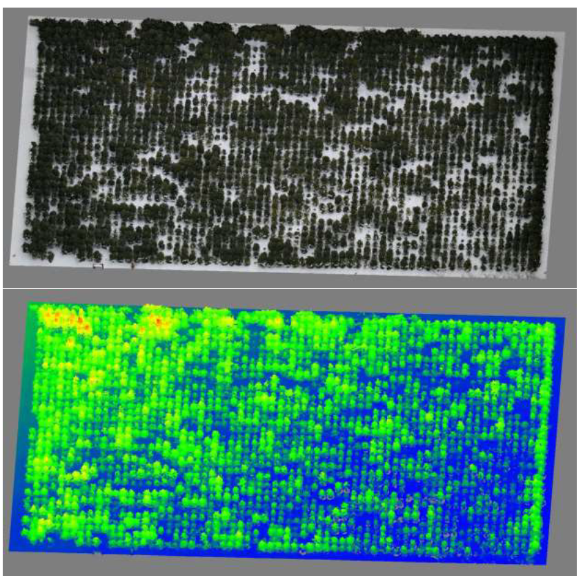
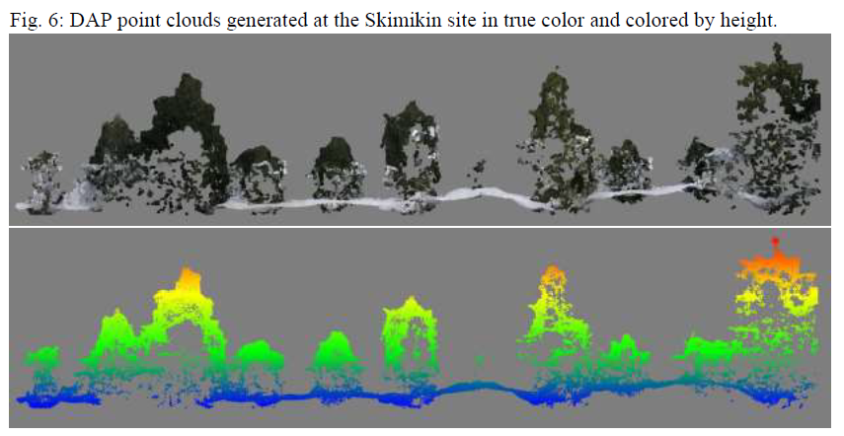

Slide 38
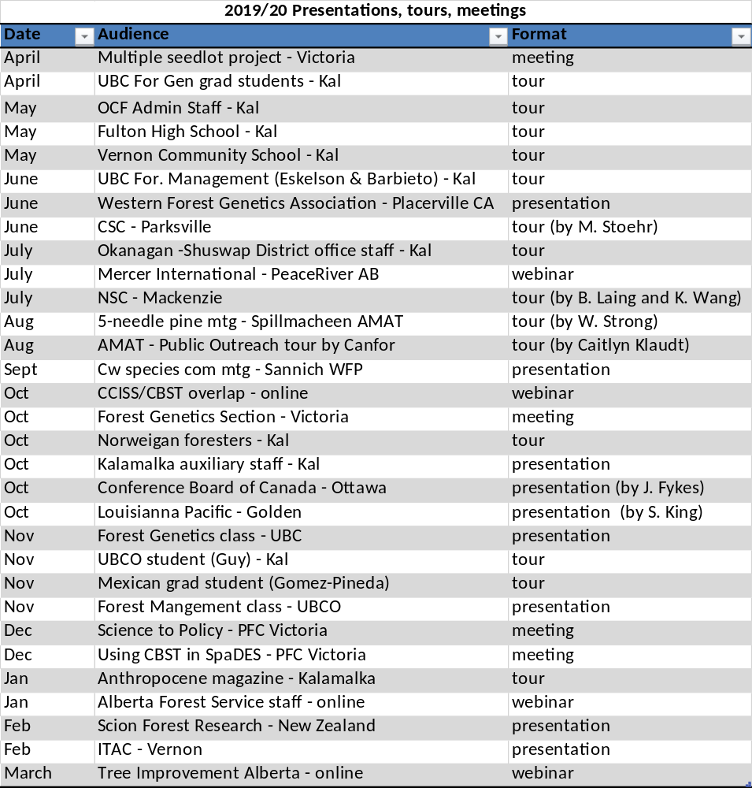
Climate Change Adaptation Research
Project updates 2020
Extension

Slide 39
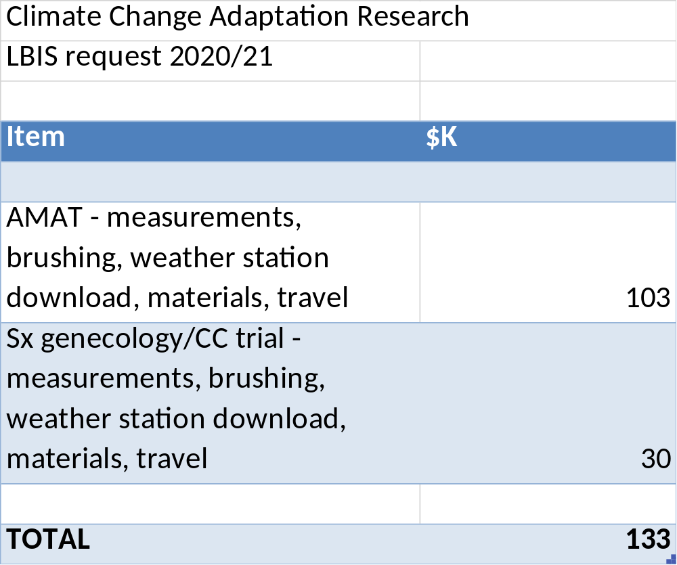

Slide 40
